Slide 1
Capstone Project Report on “Travel App & Code Playground App”
Presentation By:-
Name:- VEMPALLI MAHAMMAD AFROZ
LMS ID:- MGSA_517
Batch:- WIP-SF-13
Date:- 28/02/2023

Slide 2
Introduction
The proposed Travel Approval App is a web-based solution that simplifies the process of requesting and approving travel requests within an organization. The app is designed to automate the approval process, eliminate manual tasks, and ensure compliance with company travel policies.
The app includes a user-friendly interface that allows employees to easily submit travel requests, select travel dates, destinations, and expenses. The app also provides the ability to attach supporting documents, such as flight itineraries and hotel bookings, to the travel request for review.

Slide 3
Modules
This project consists of 3 Modules.
Module-1
Module-2
Module-3

Slide 4
Module-1

Slide 5
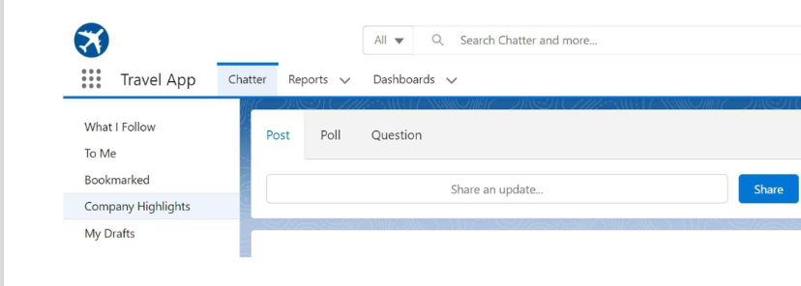
Create a new custom lightning App.

Slide 6
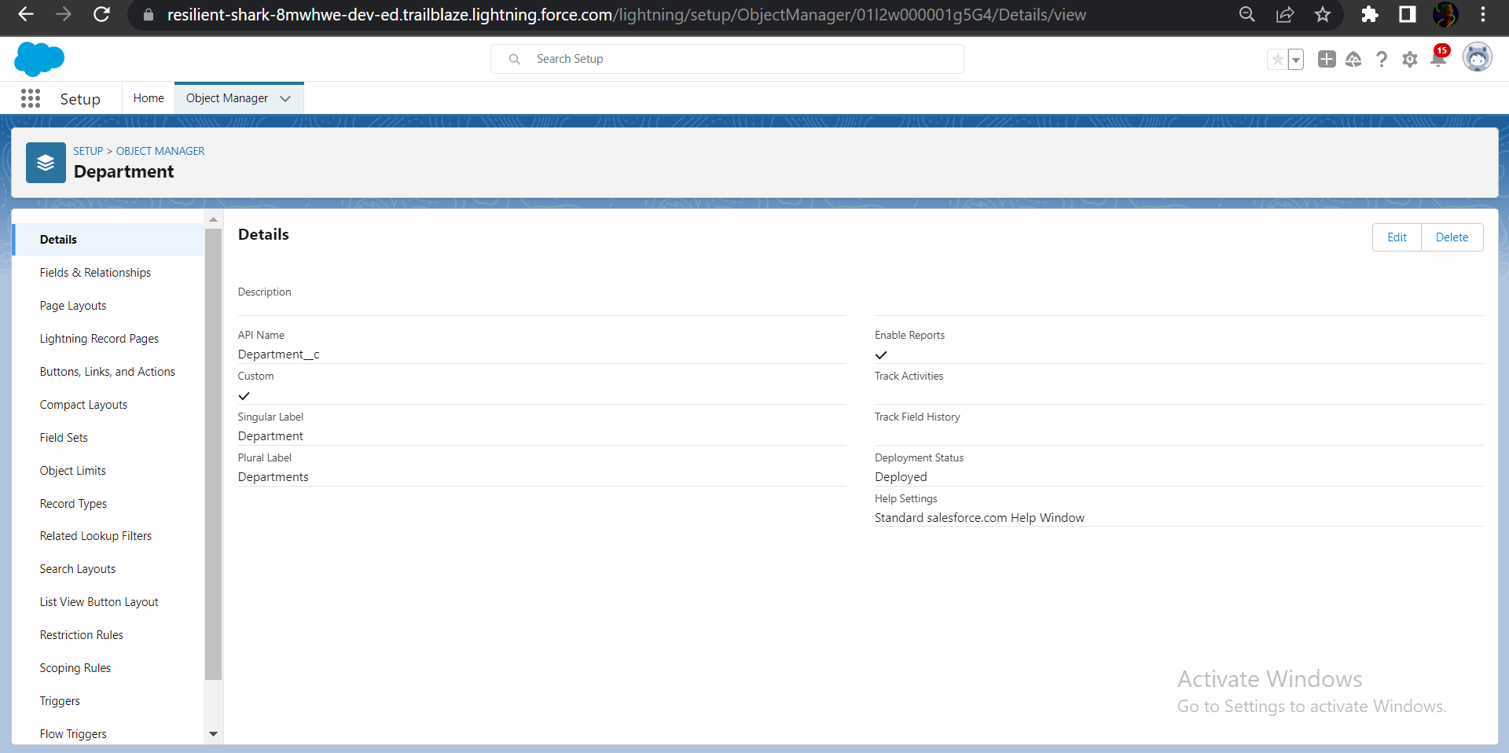
Custom Objects

Slide 7
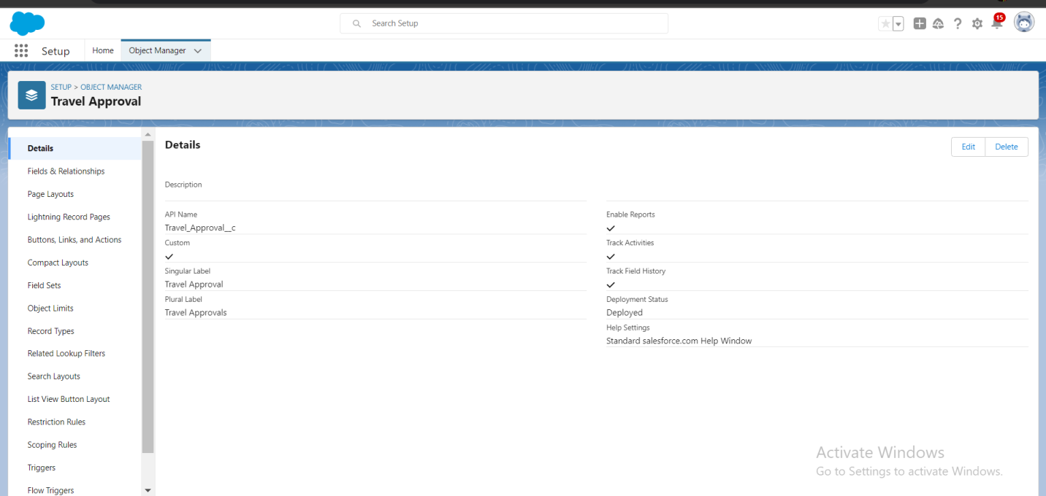

Slide 8
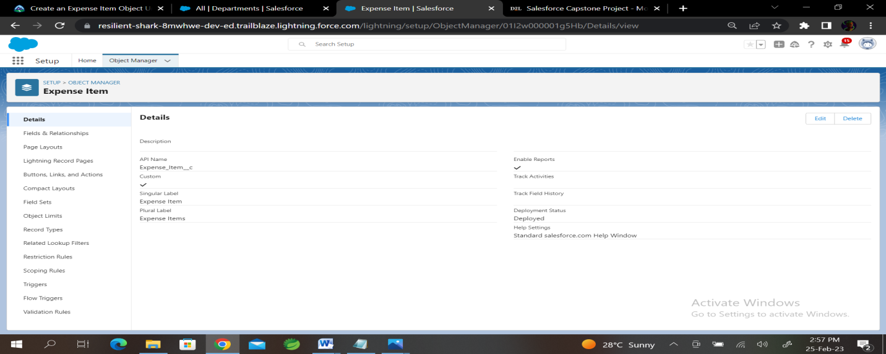

Slide 9
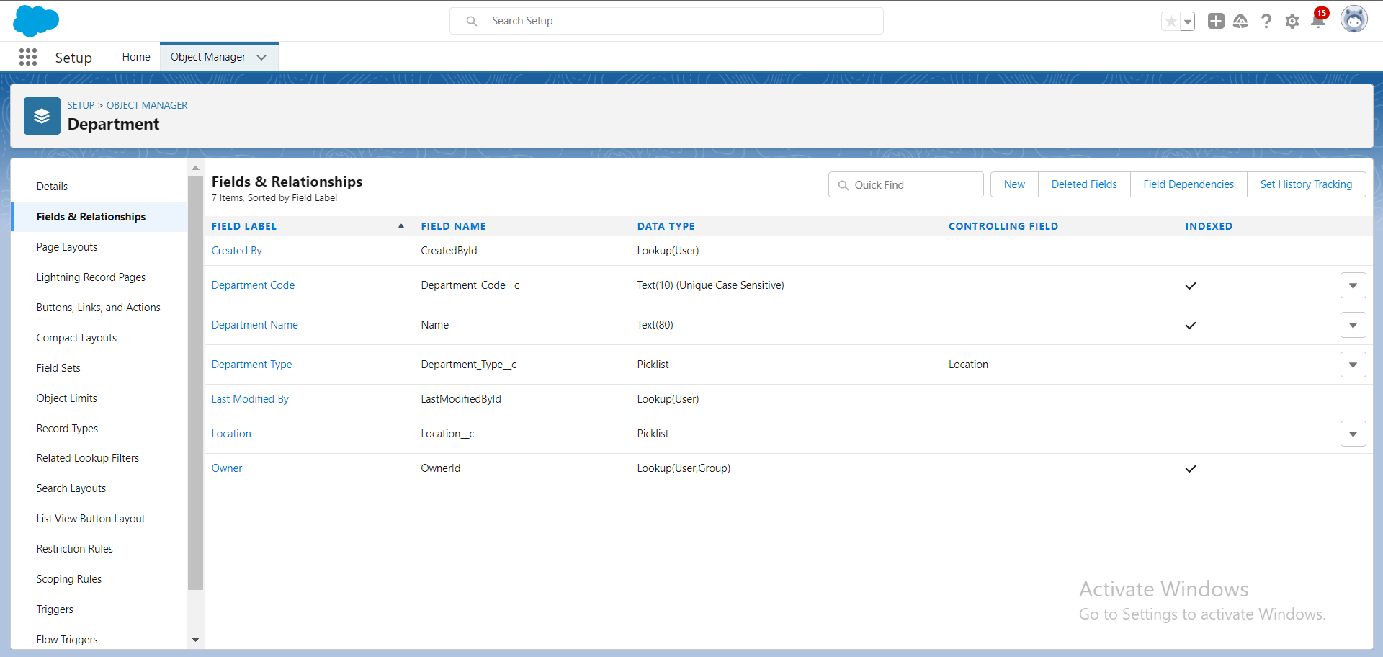
Custom Fields

Slide 10
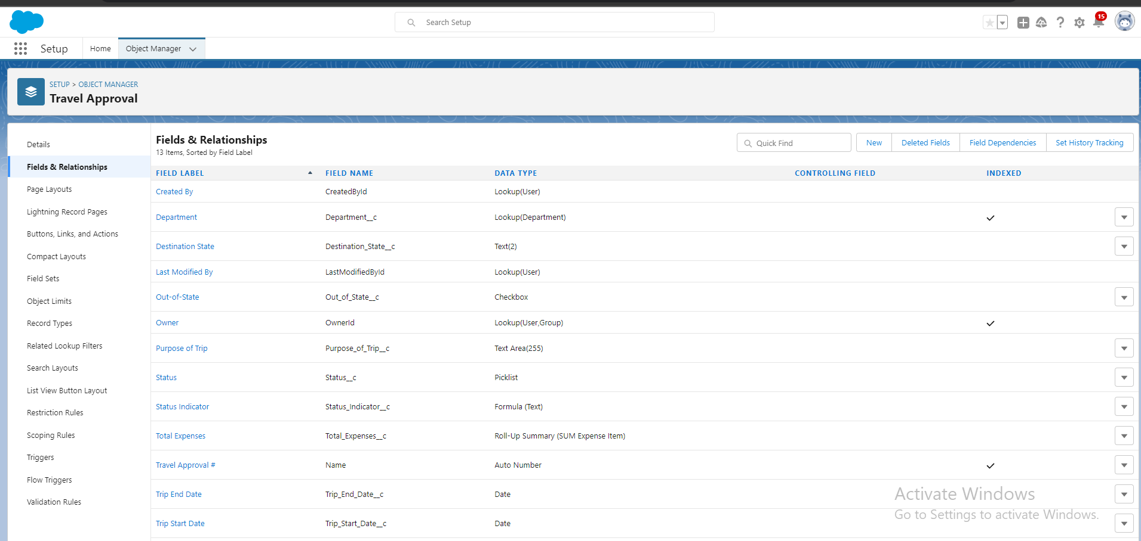

Slide 11
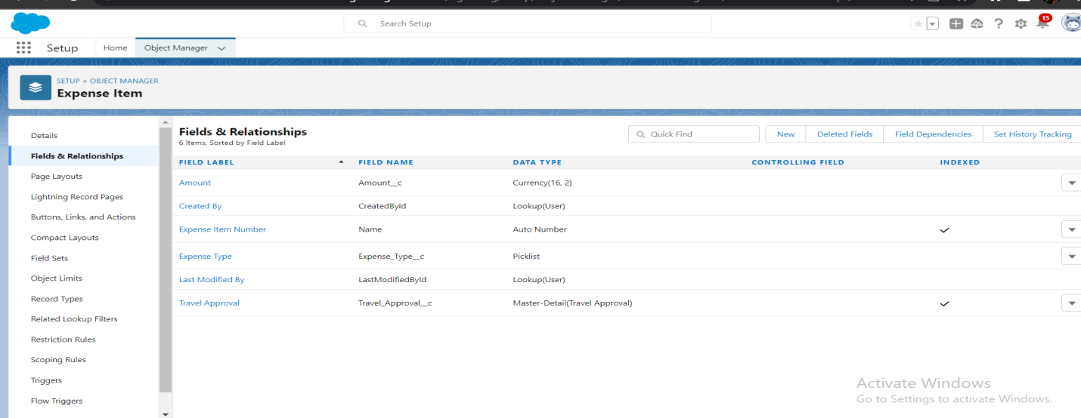

Slide 12
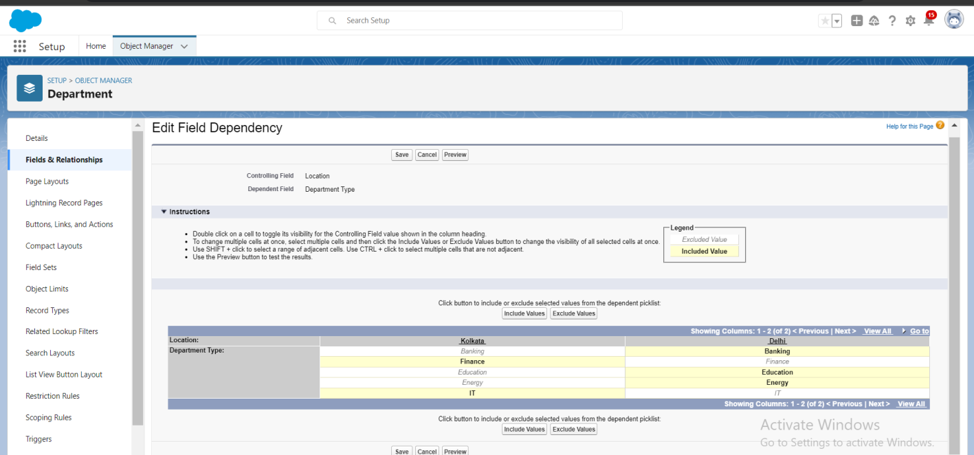
Create Field Dependency

Slide 13
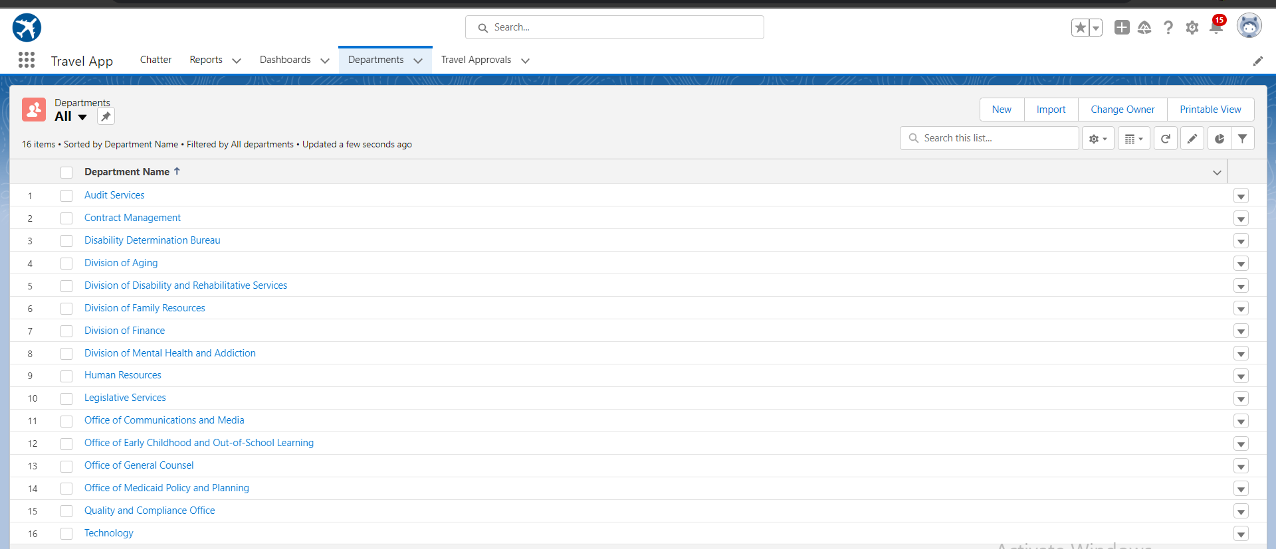
Import Department Data

Slide 14
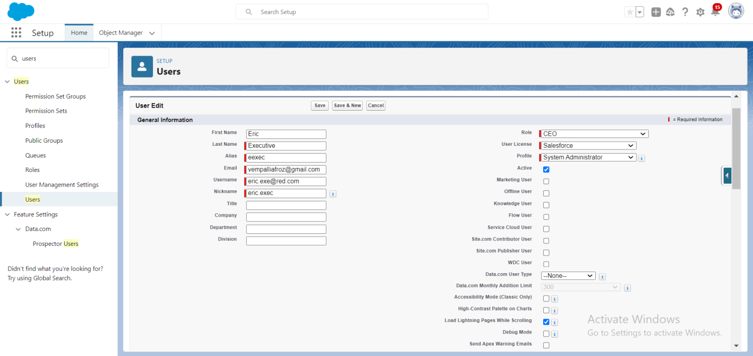
Create a User

Slide 15
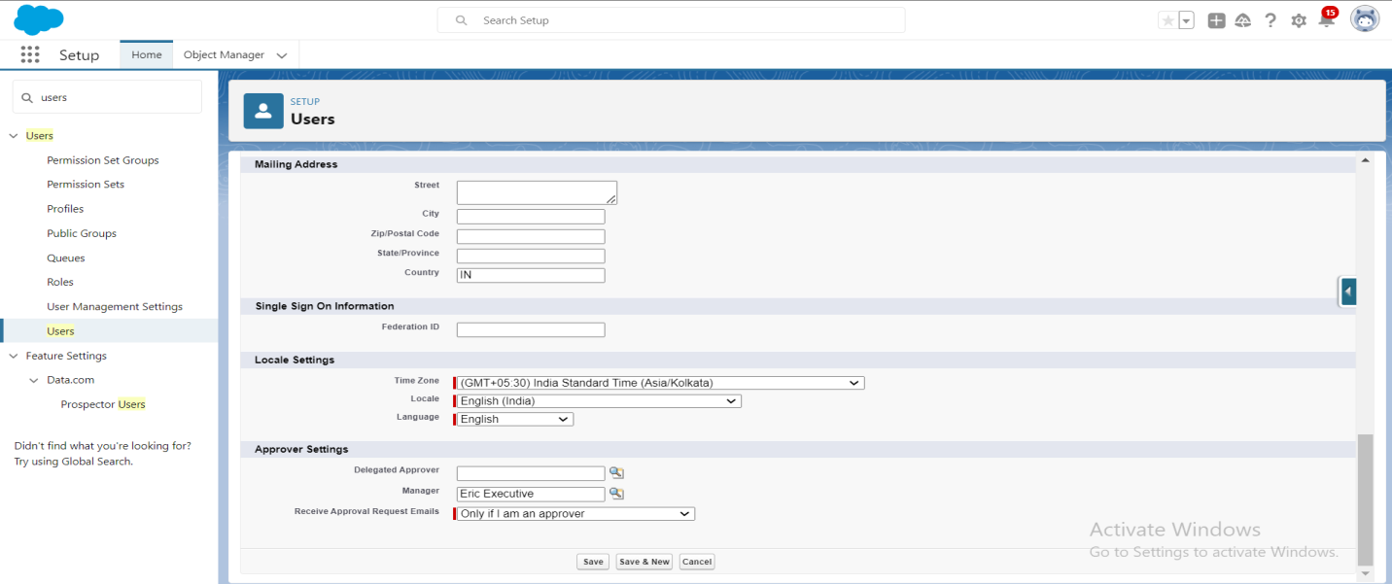

Slide 16
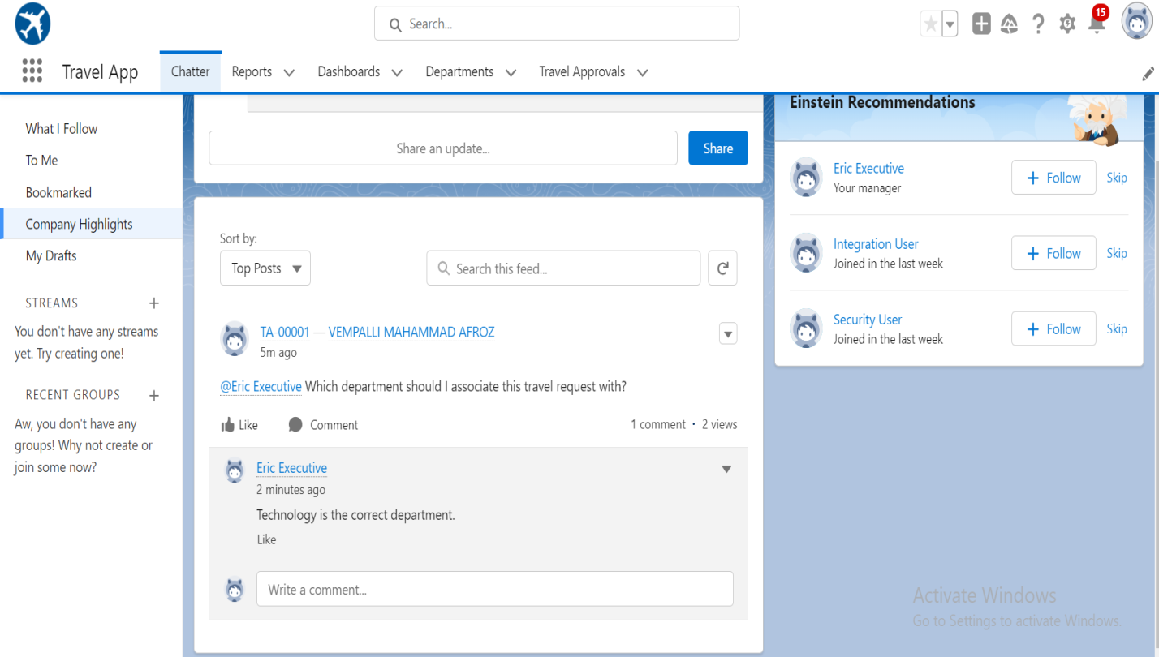
Chatter

Slide 17
Module-2

Slide 18
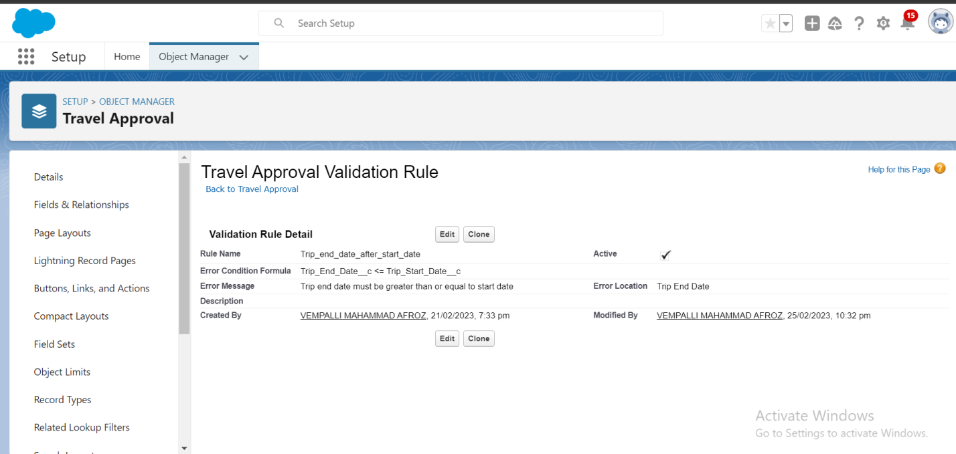
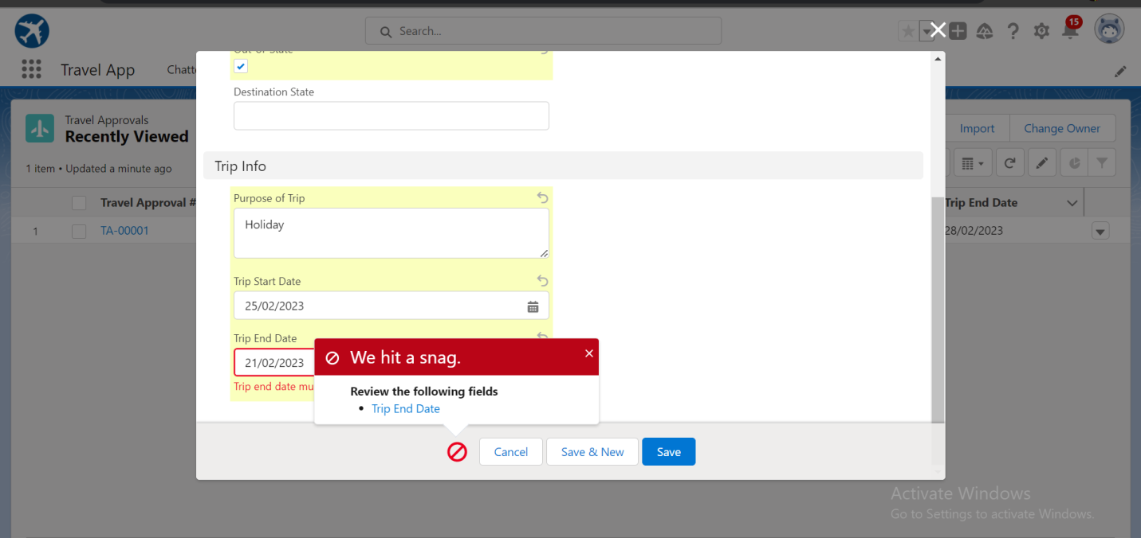
Validation Rule

Slide 19
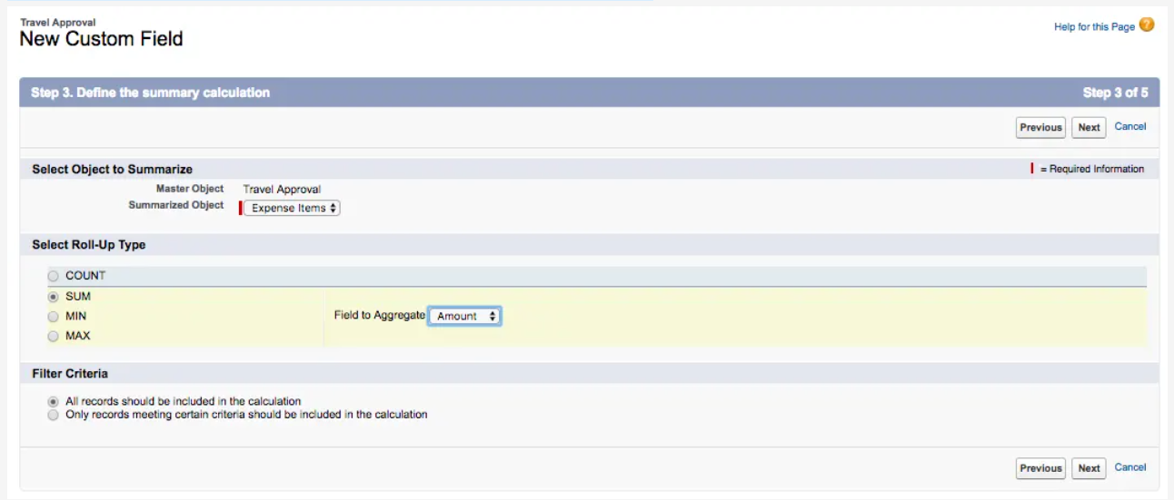
Roll-Up Summary

Slide 20
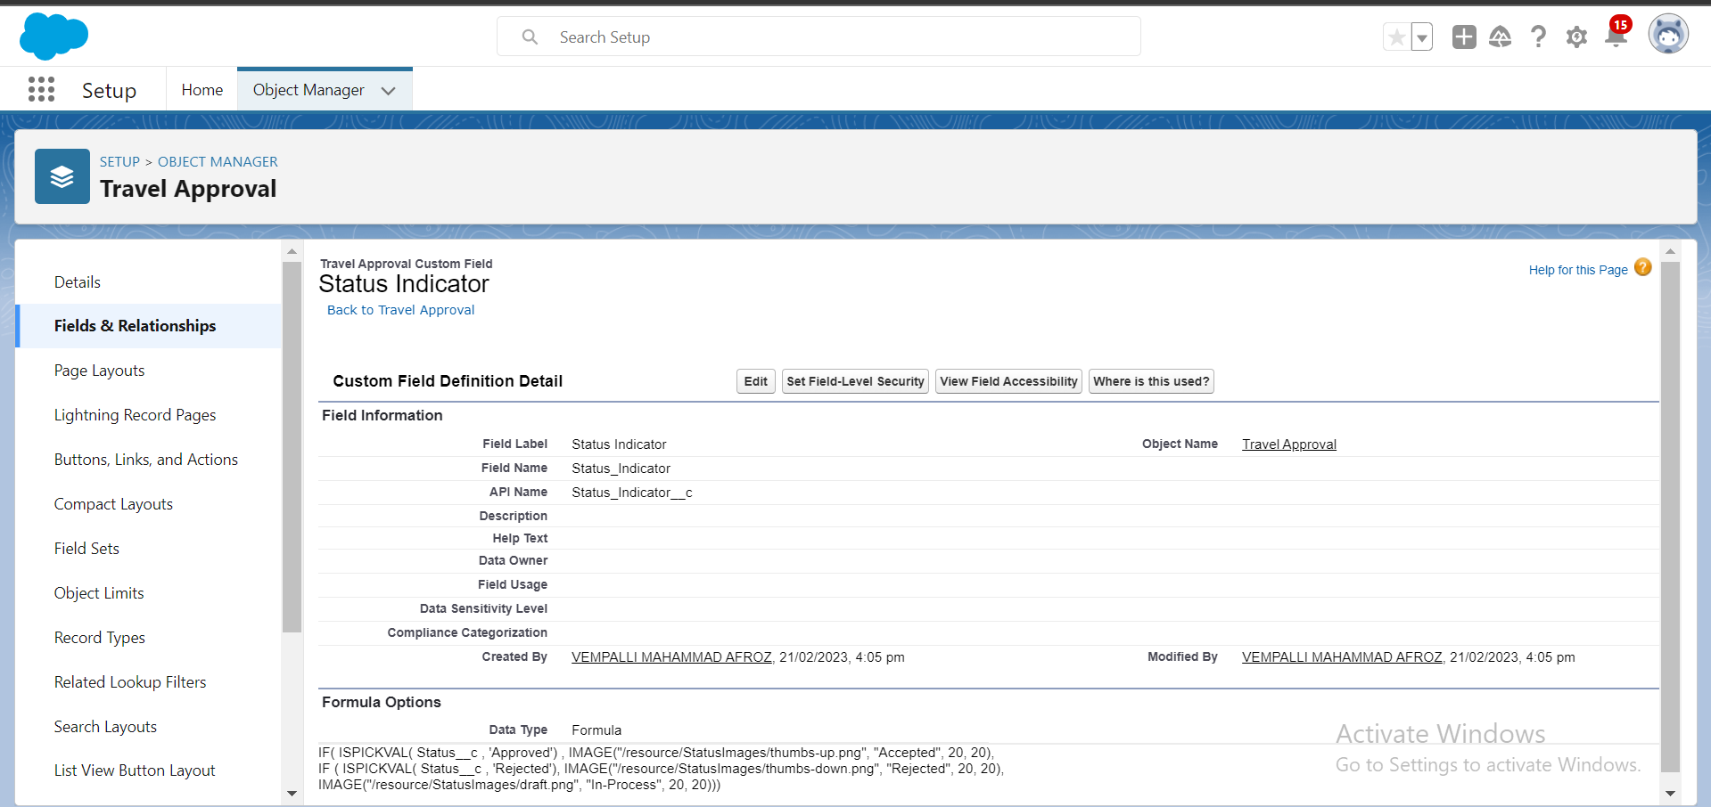
Create Formula

Slide 21
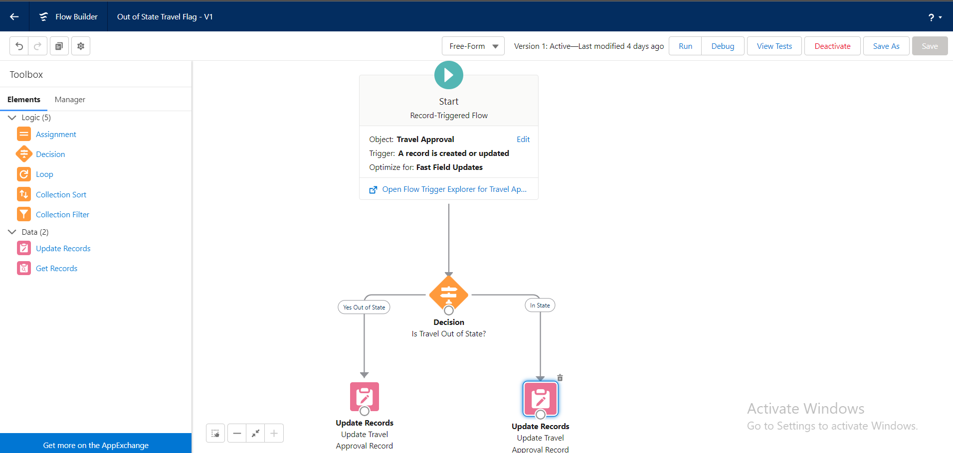
Create a Record – Triggered Flow.

Slide 22
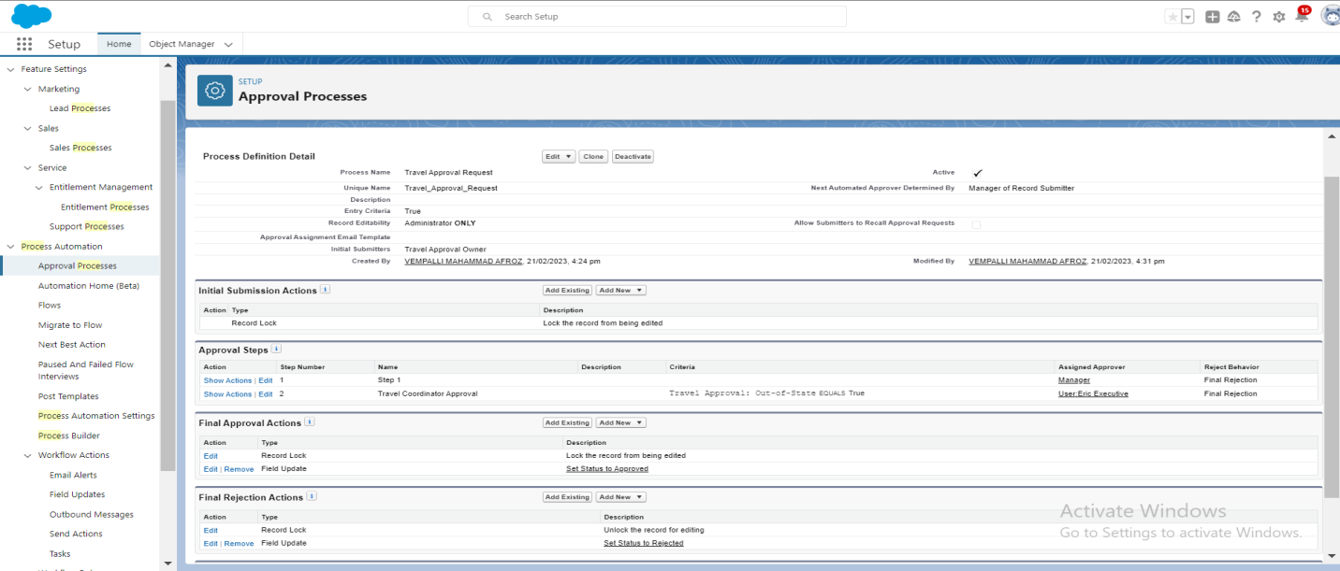
Create an Approval Process

Slide 23
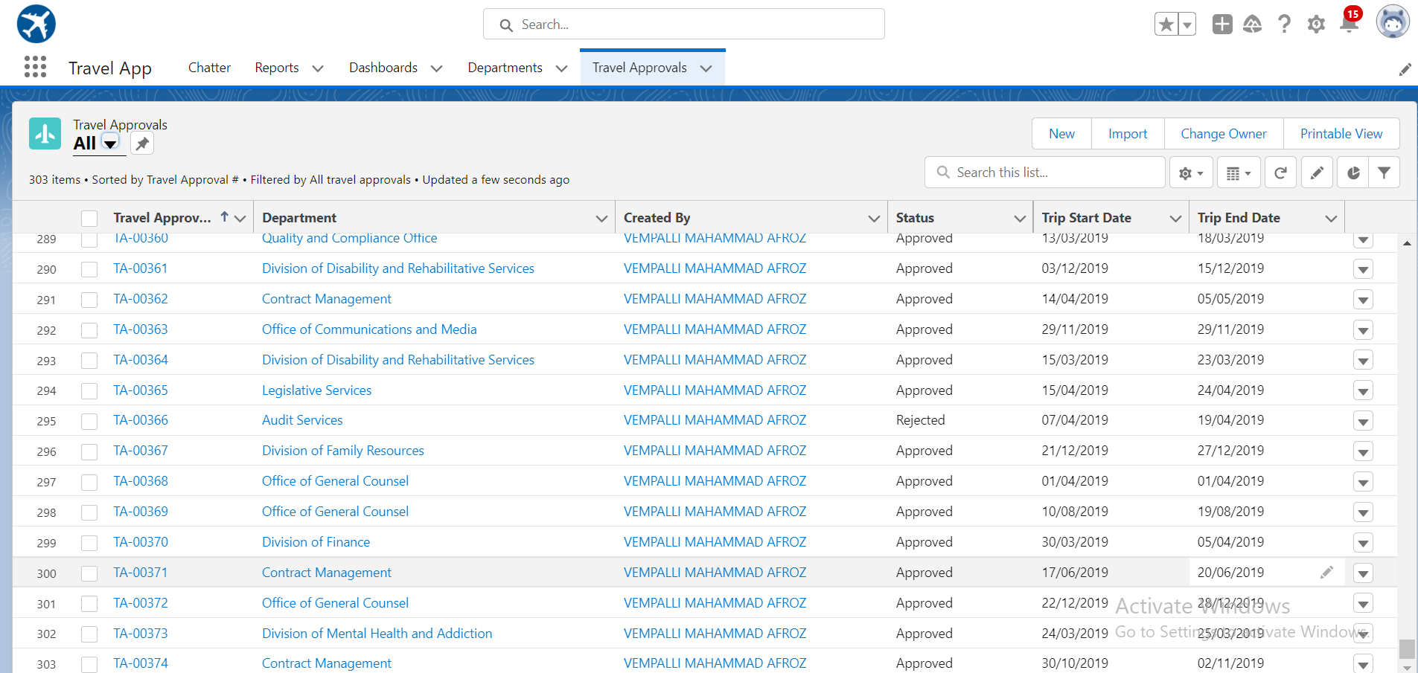
Import Travel Approval Data

Slide 24
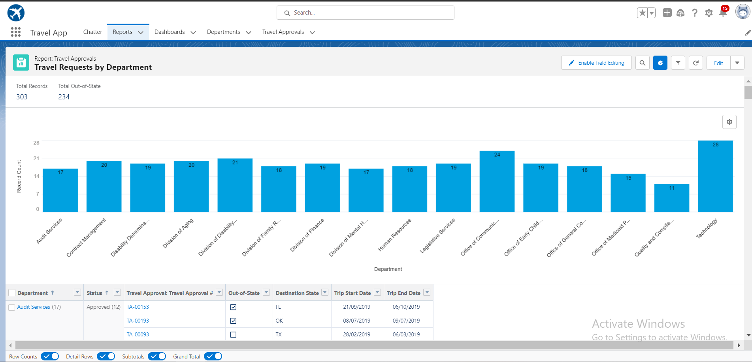
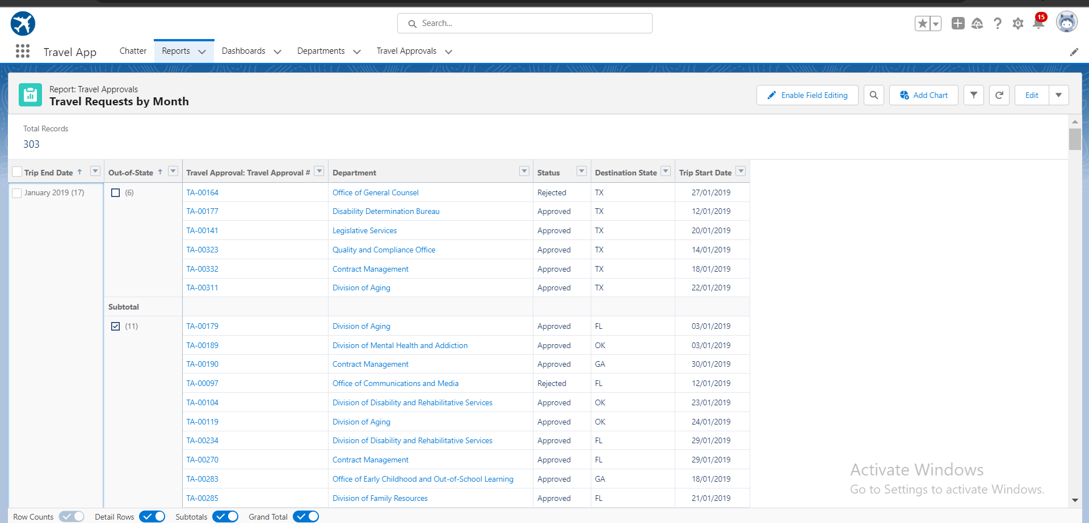
Reports

Slide 25
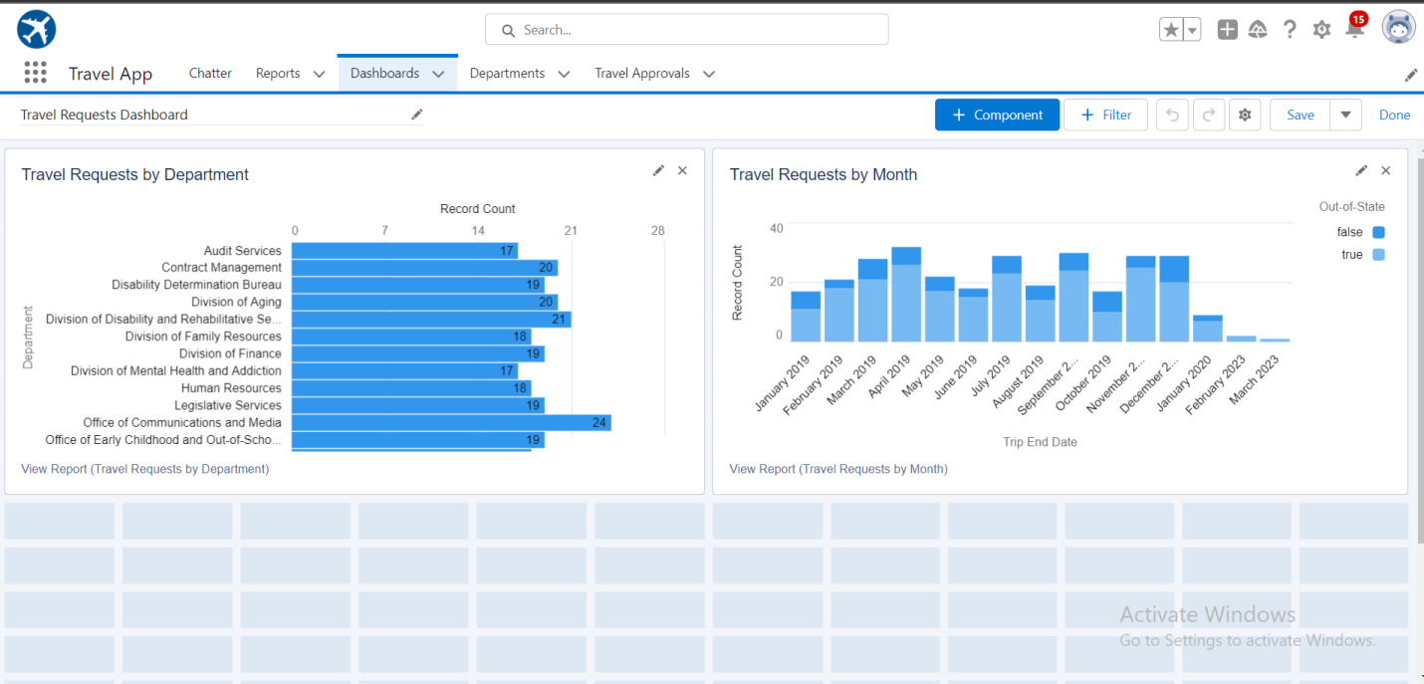
Dashboard

Slide 26
Module-3

Slide 27
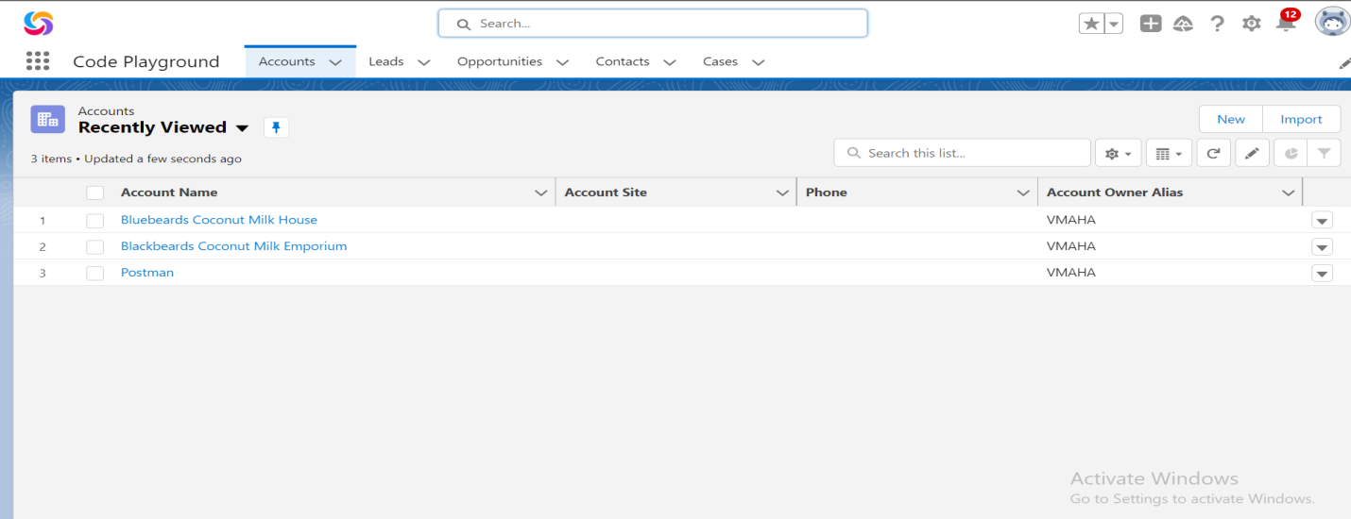
Create a Lightning App

Slide 28
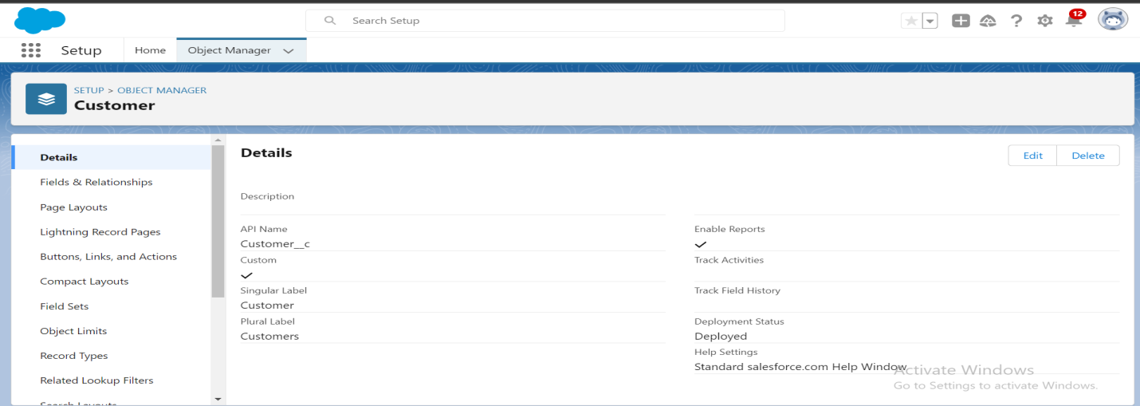
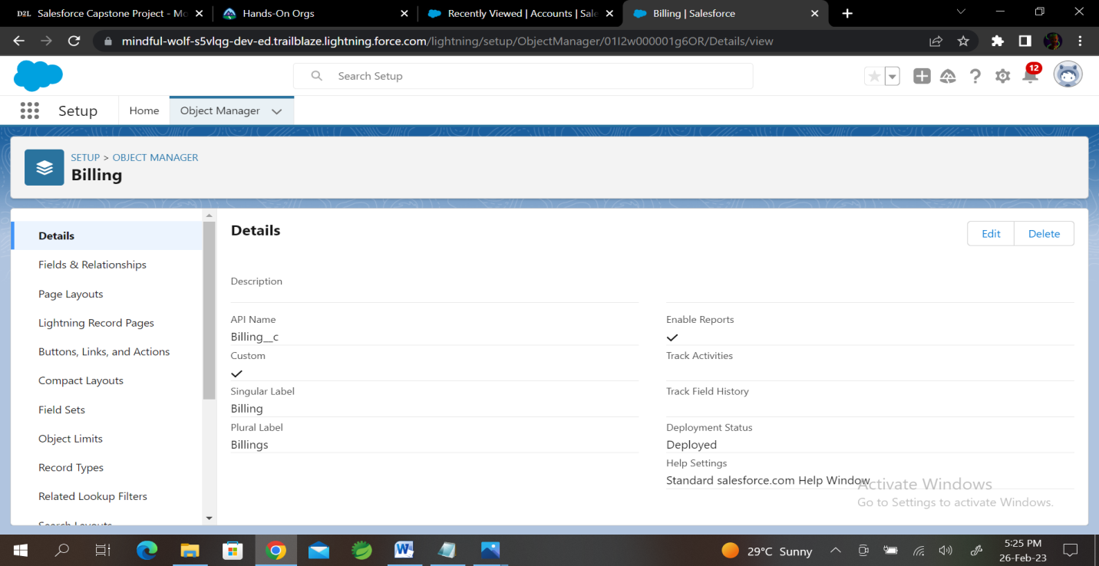
Custom Objects

Slide 29
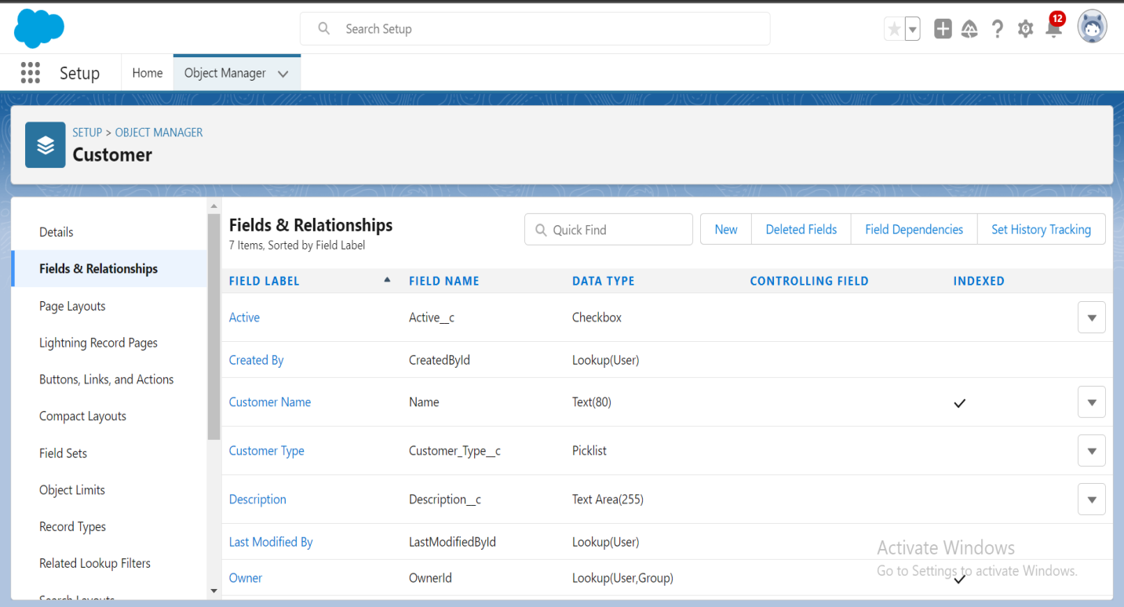
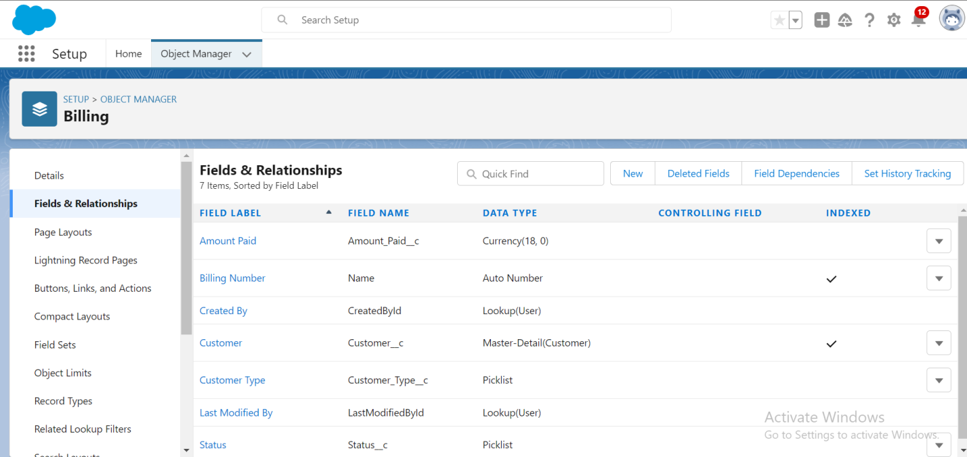
Custom Fields

Slide 30
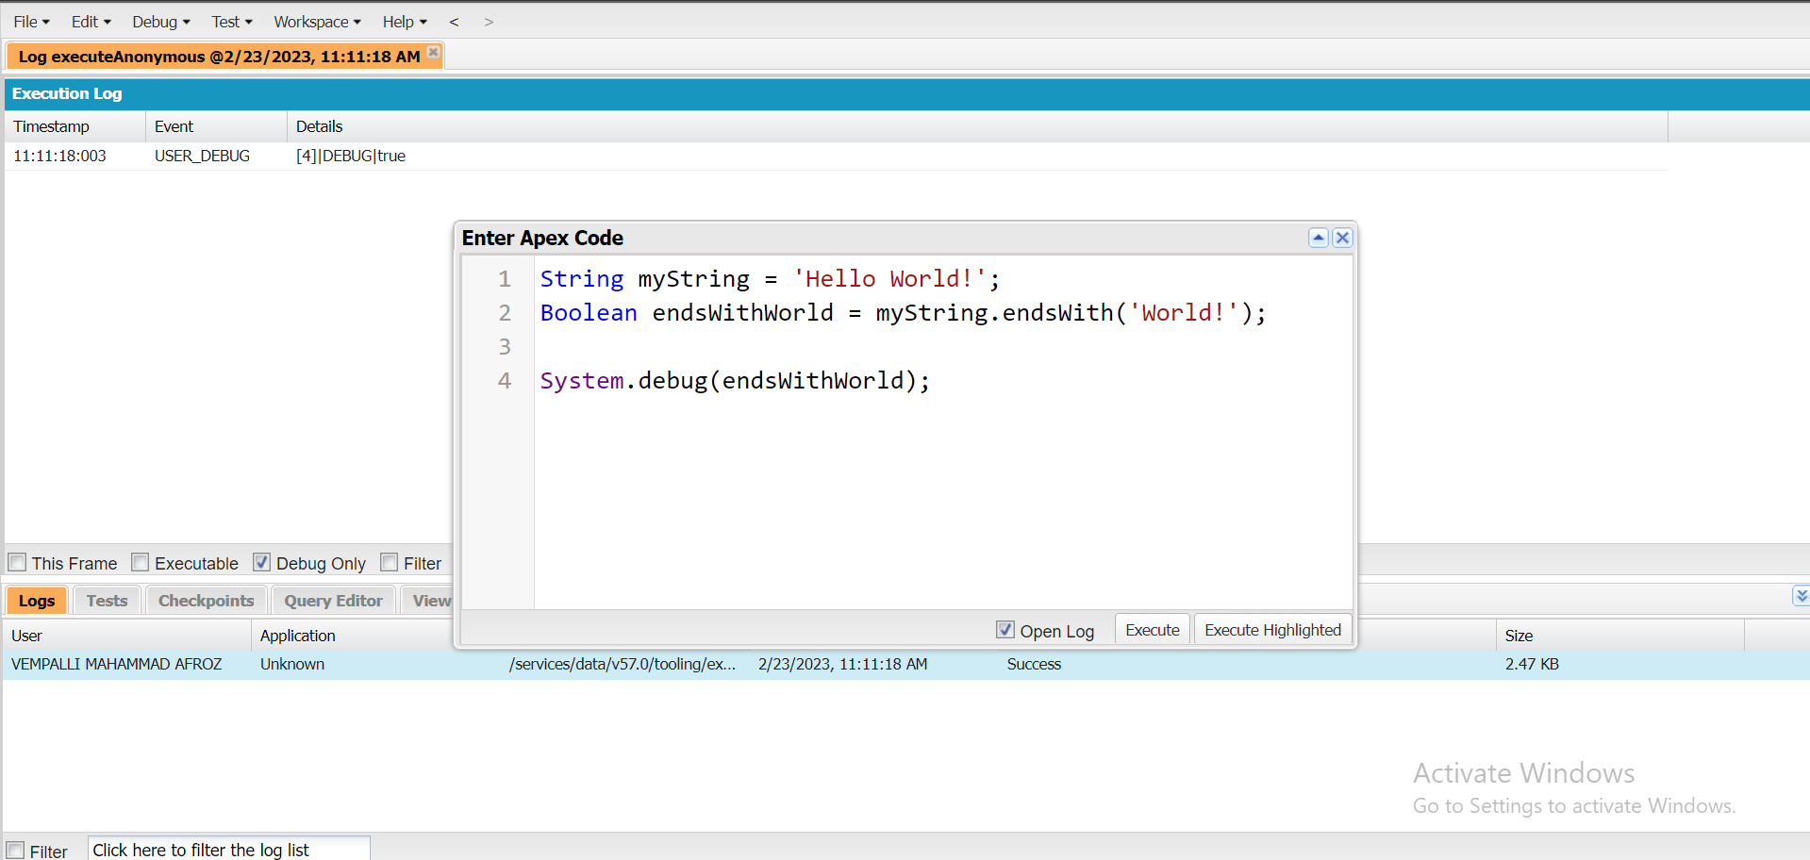
Exercise-2
Use string method ‘endsWith’ to display the output.

Slide 31
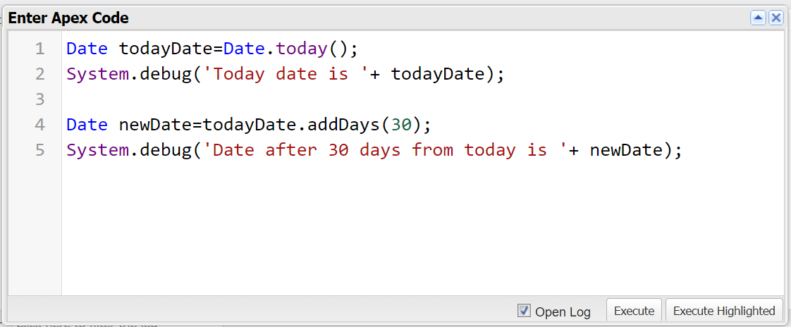
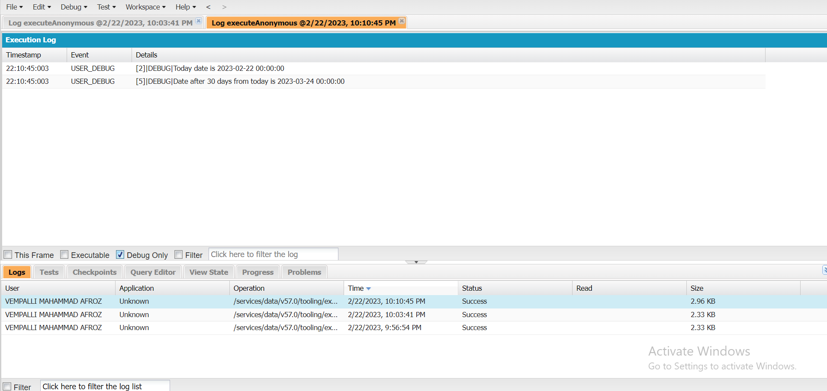
2. Use Date method today() & addDays(30) to display the output.

Slide 32
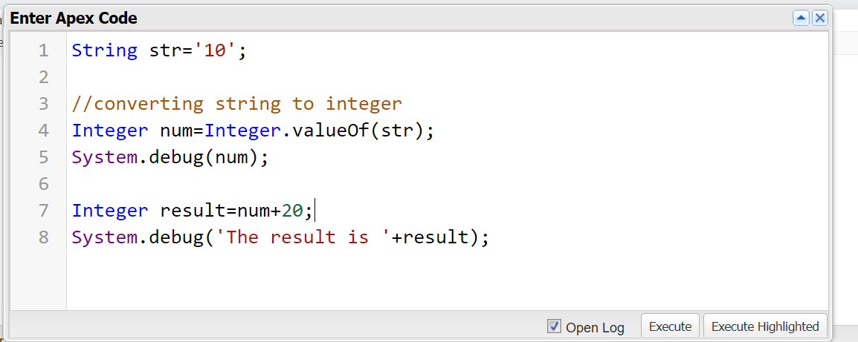
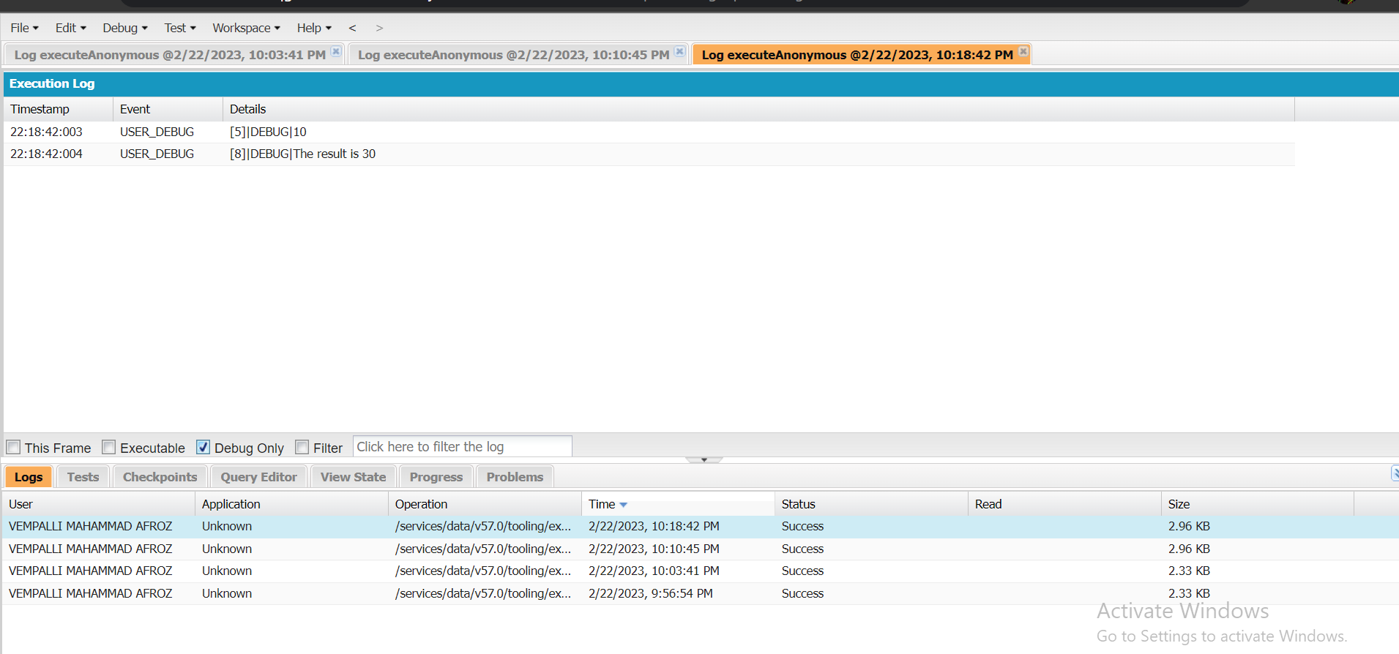
3. Display the output of an Integer variable from string ‘10’ and then add 20 to it.

Slide 33
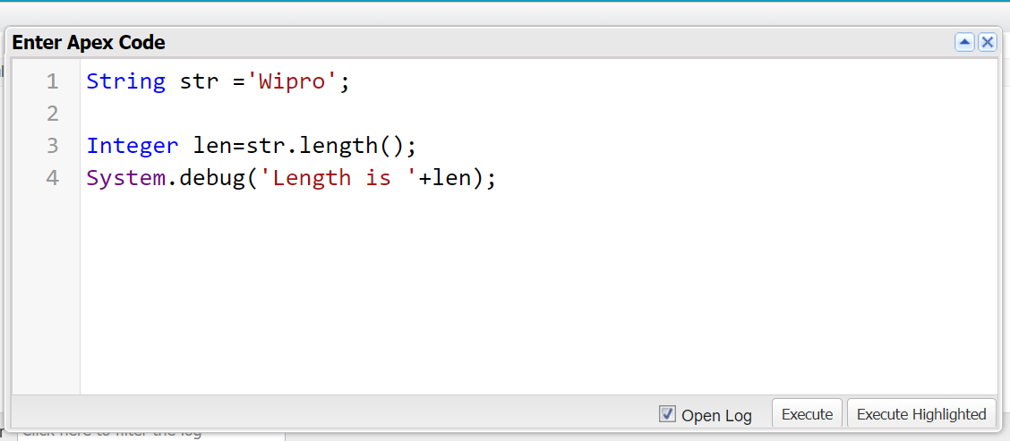
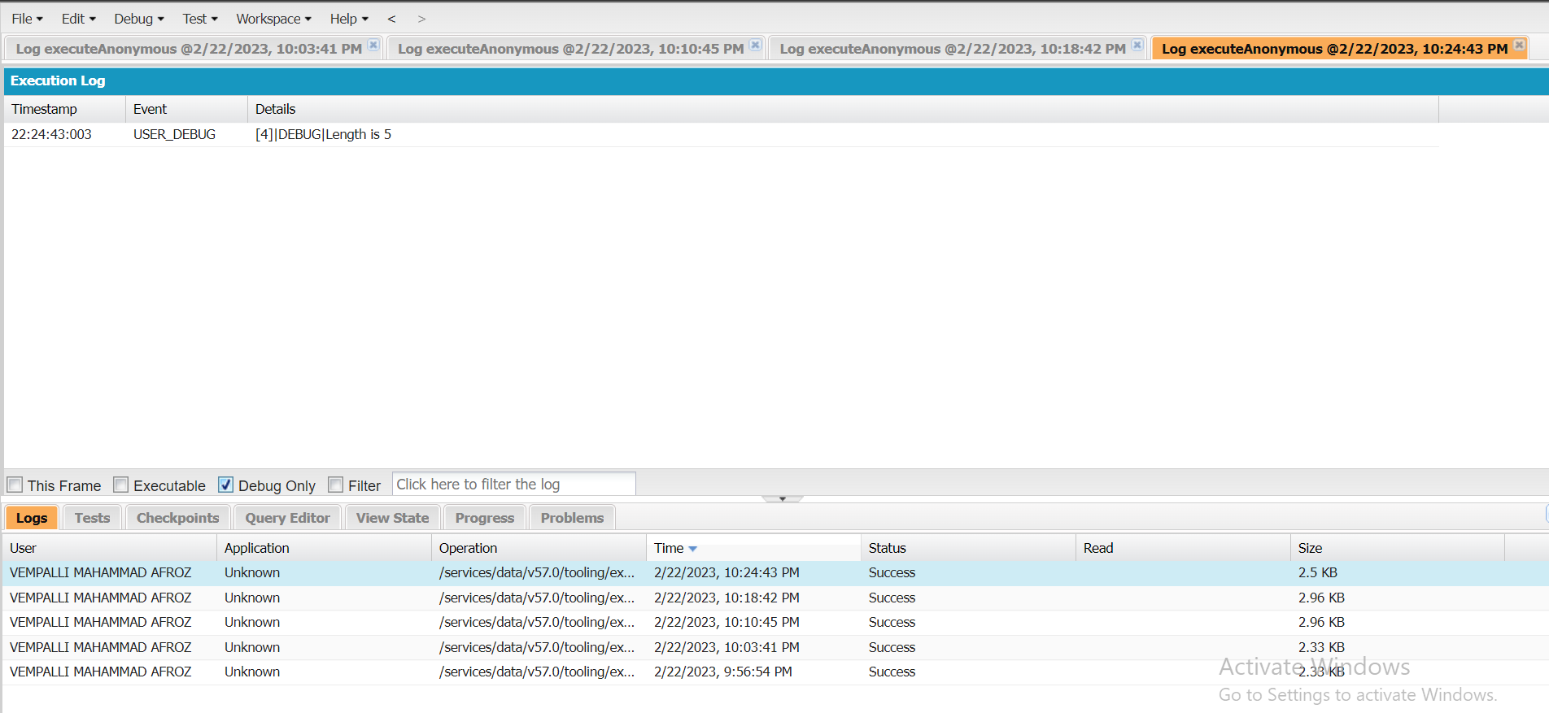
4. Use string method length() to display the output.

Slide 34
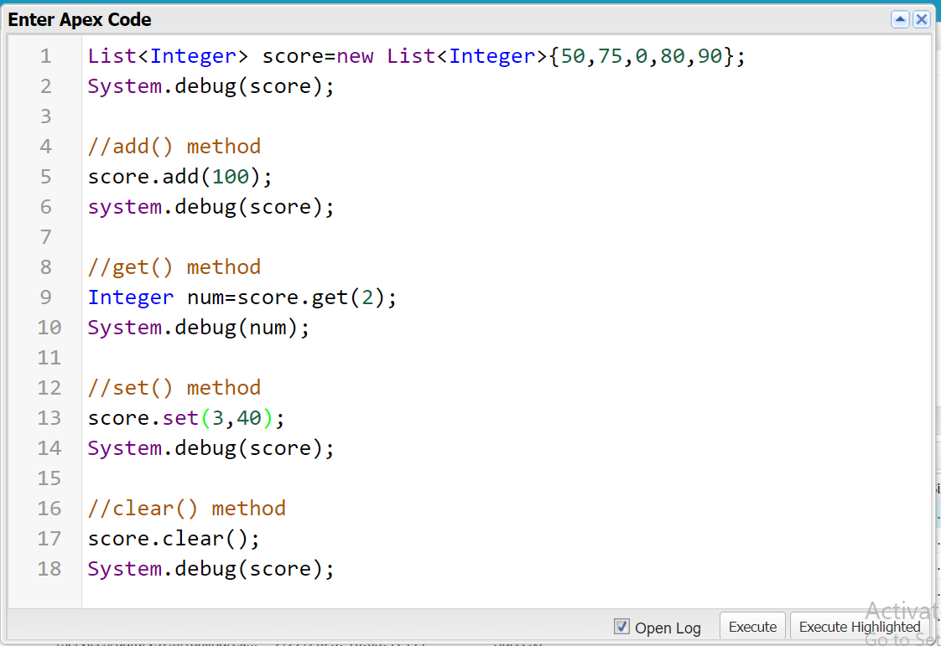
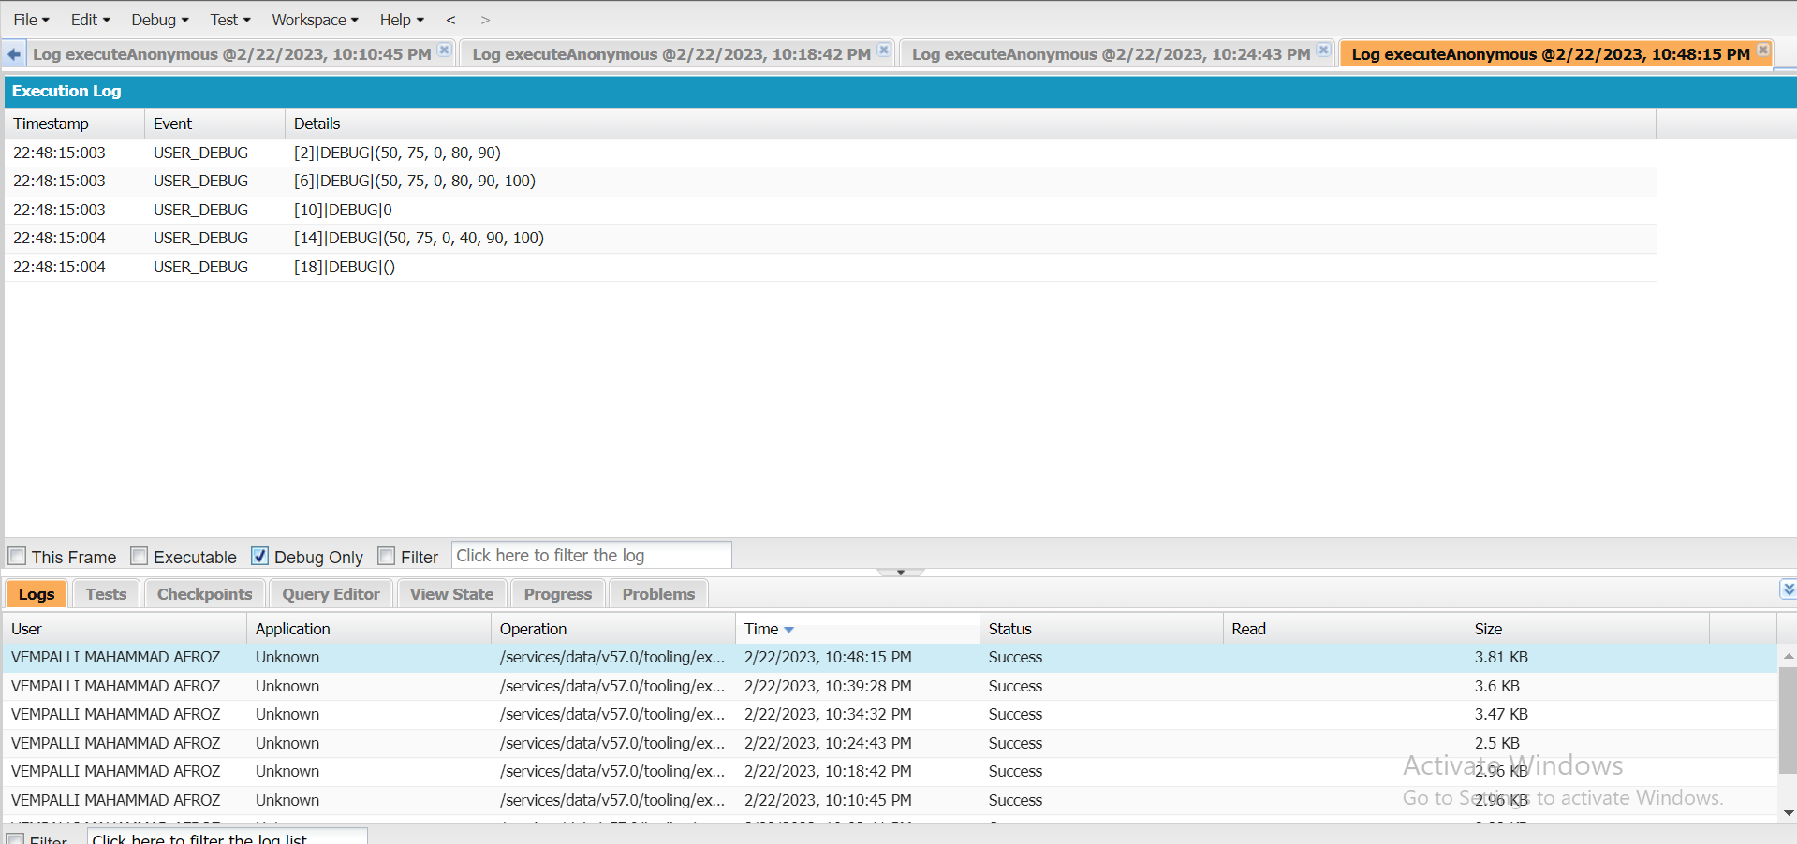
5. Display the output using add(), get(), set(), clear(), methods.

Slide 35
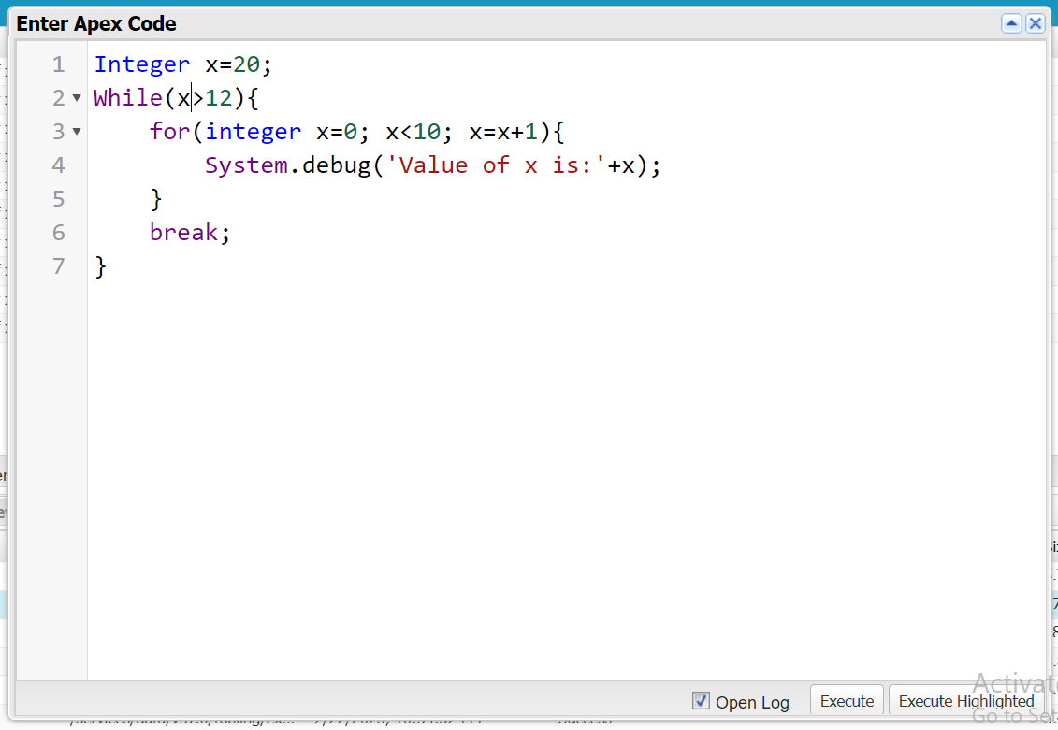
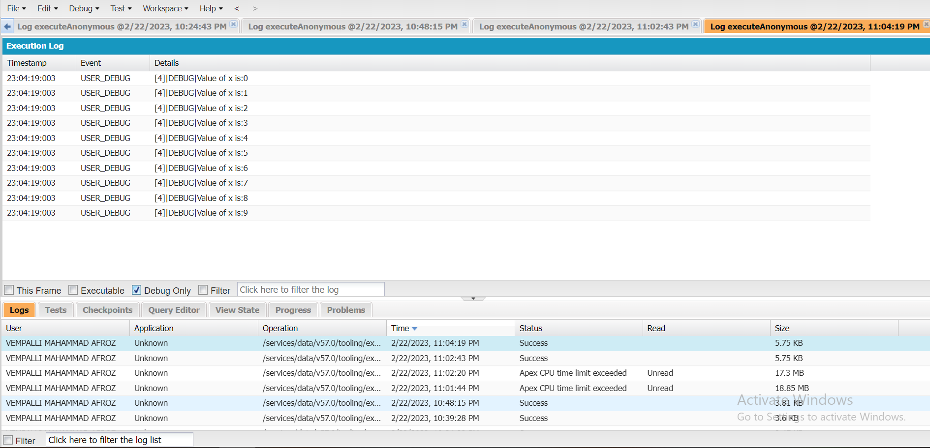
6. Execute the following code to display the value of x = 0 to 9.

Slide 36
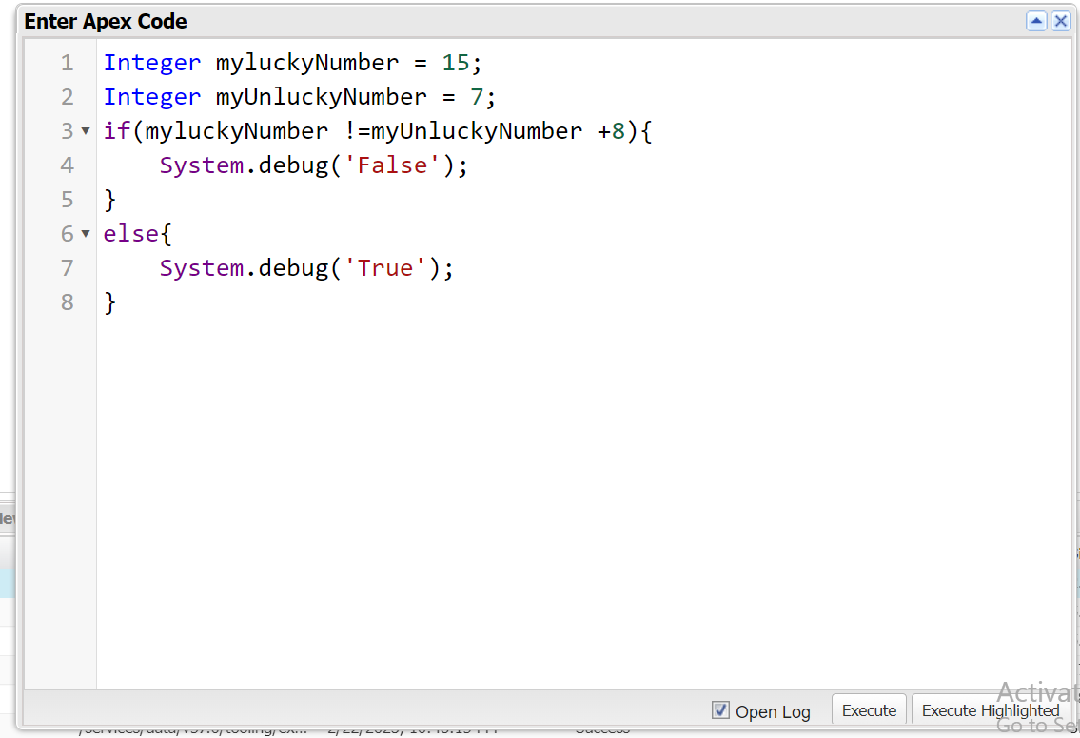
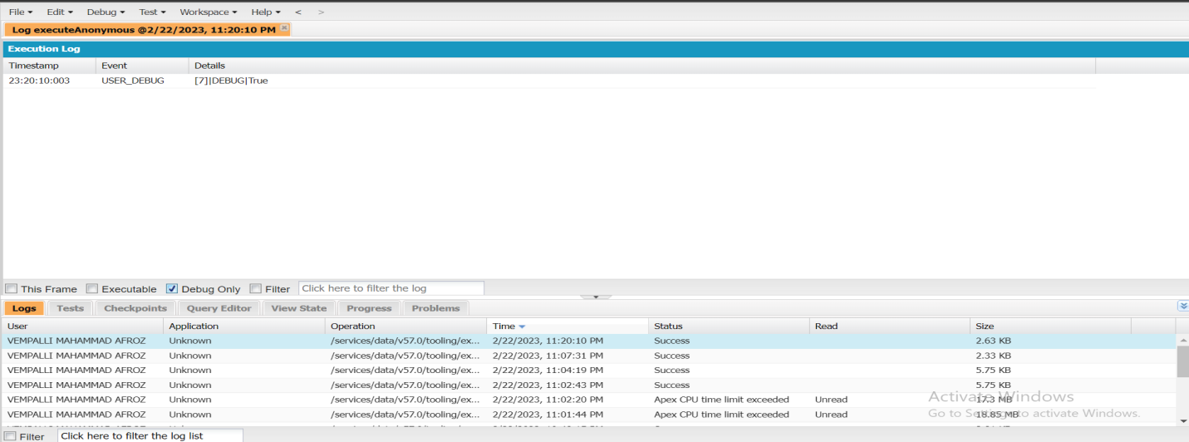
Exercise-3

Slide 37
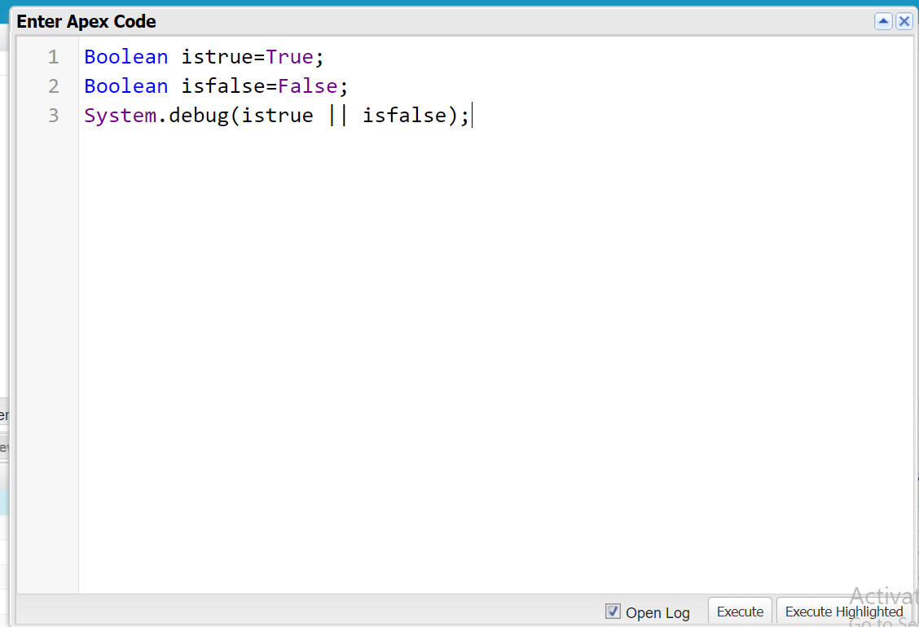
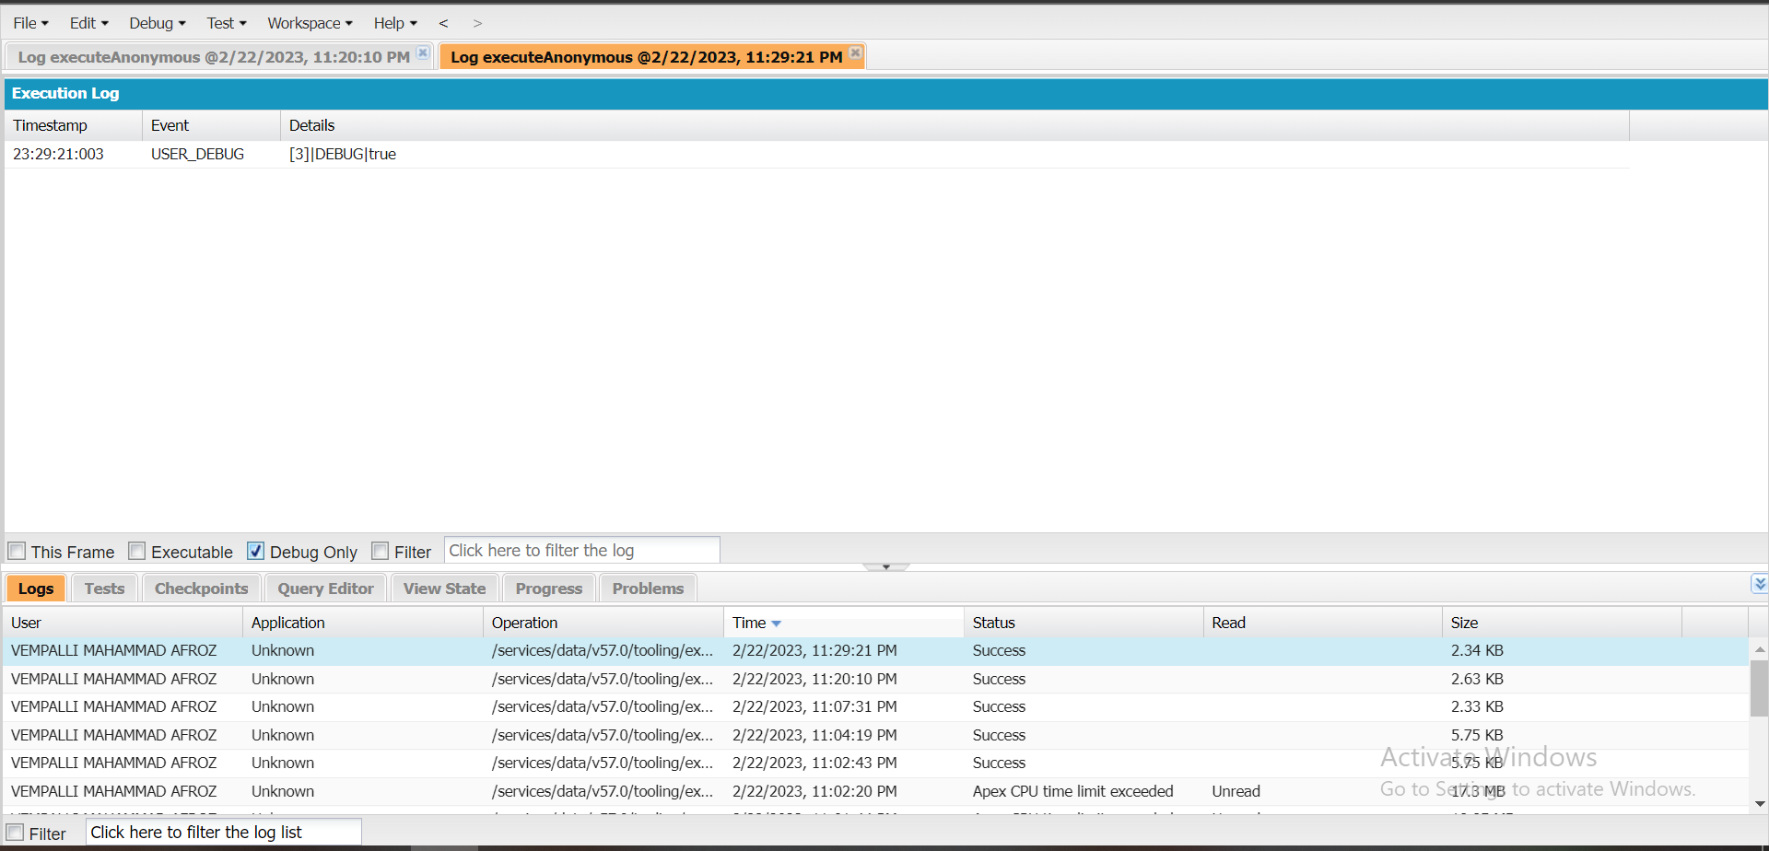
Exercise-4

Slide 38
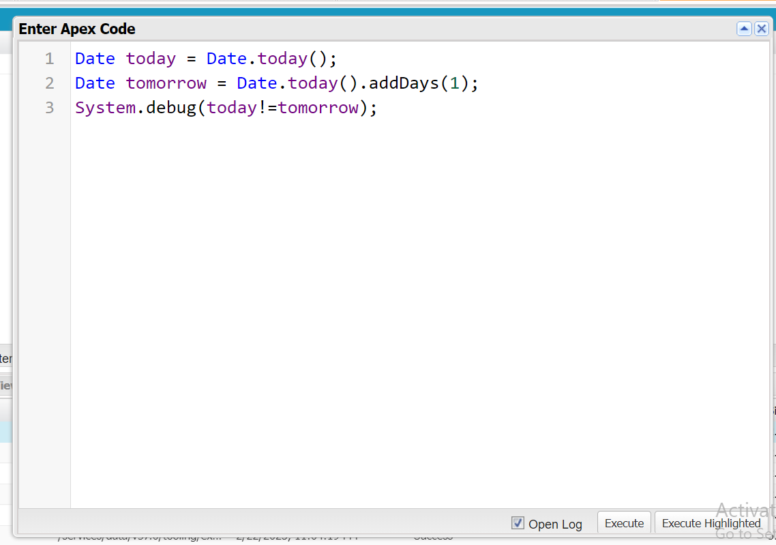
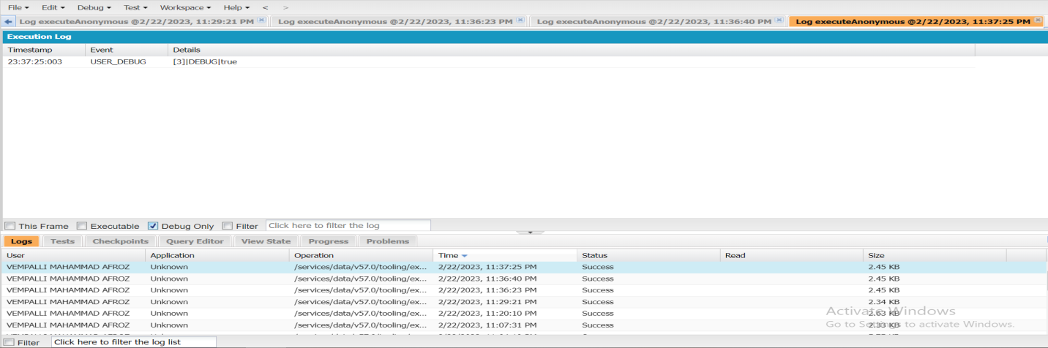
Exercise-5

Slide 39
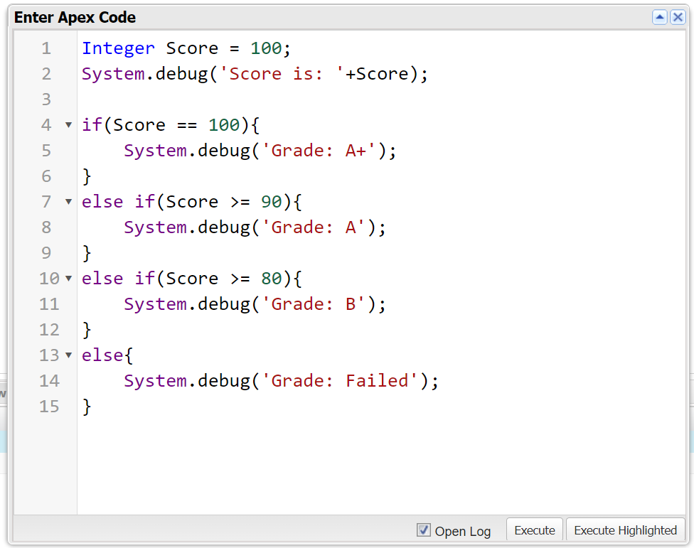
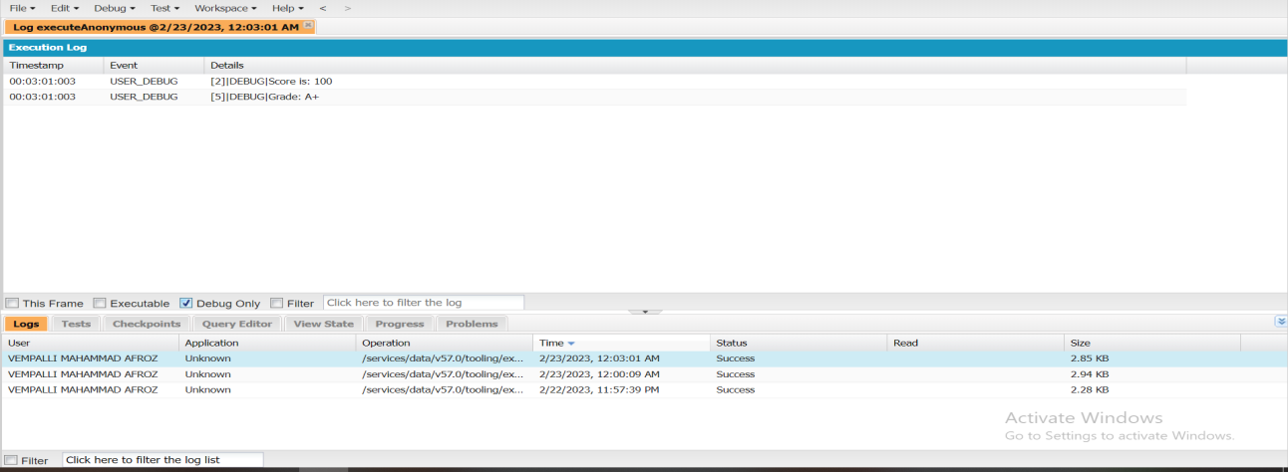
Exercise-6

Slide 40
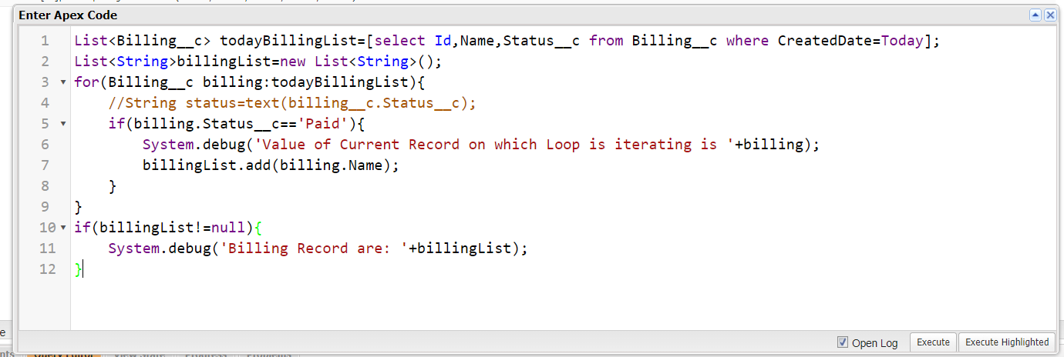
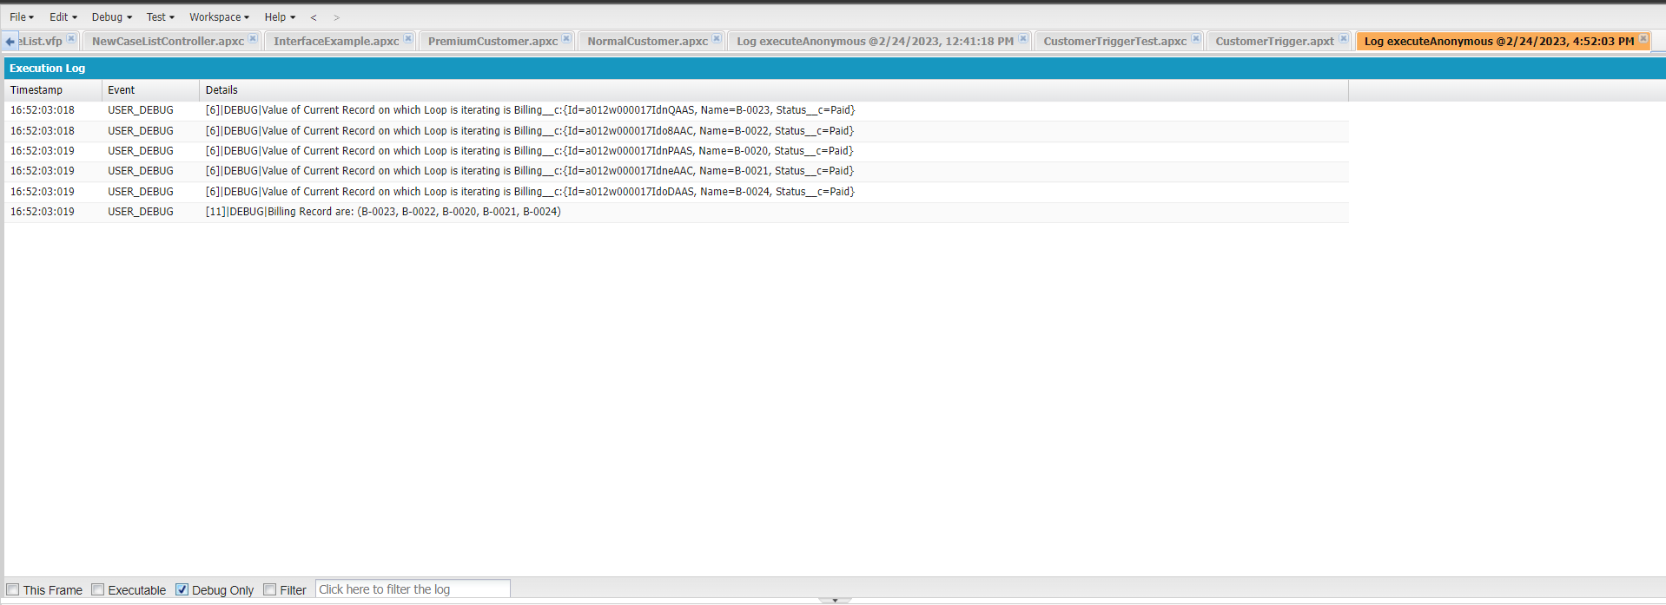
Exercise-7

Slide 41
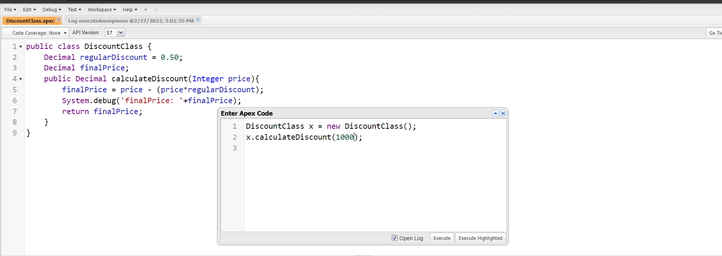
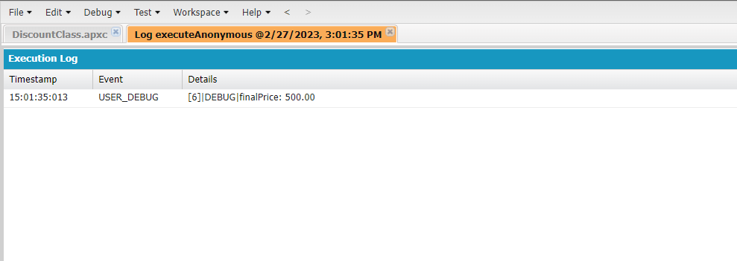
Exercise-8

Slide 42



Exercise-9

Slide 43



Slide 44


Exercise-10

Slide 45

Exercise-11

Slide 46


Exercise-12 & 13

Slide 47


Exercise-14 & 15

Slide 48


Exercise-16

Slide 49


Exercise-17

Slide 50



Exercise-18

Slide 51
Thank you!

